Slide 1
async/await: Fetch API, AJAX basics, Event loop & concurrency model.
Introduction to Git.
Department of Computer Science and Engineering
Chitkara University, Punjab

Slide 2
Async and Await in JavaScript
Async/Await in JavaScript allows you to write asynchronous code in a clean, synchronous-like manner, making it easier to read, understand, and maintain while working with promises.
async functions always return a Promise.
await pauses execution until the Promise is resolved or rejected.
Improves readability compared to .then() and .catch() chaining.
Makes error handling simpler using try...catch.
Ideal for managing complex asynchronous flows in a structured way.

Slide 3
Async and Await in JavaScript
Syntax:
async function functionName() {
try {
const result = await someAsyncFunction();
console.log(result);
} catch (error) {
console.error("Error:", error.message);
}
}

Slide 4
Async and Await in JavaScript
Async Function
Async functions let us write promise-based code in a synchronous-looking way, improving readability while keeping the execution non-blocking. An async function always returns a Promise—if it returns a non-promise value, JavaScript automatically wraps it in a resolved Promise.
Makes asynchronous code easier to read and maintain
Does not block the main execution thread
Always returns a Promise
Non-promise return values are auto-wrapped in Promise.resolve()
Works seamlessly with await for handling promises

Slide 5
Async and Await in JavaScript
Syntax:
async function myFunction() {
return "Hello";
}

Slide 6
Async and Await in JavaScript
Await Keyword
The await keyword pauses the execution of an async function until a Promise is resolved or rejected. It can only be used inside an async function, making asynchronous code easier to read and manage.
Used to wait for a Promise to settle.
Can only be used inside async functions.
Prevents callback and .then() chaining.
Makes asynchronous code cleaner and more readable.
Supports error handling with try...catch.

Slide 7
Async and Await in JavaScript
const getData = async () => {
let y = await "Hello World";
console.log(y);
}
console.log(1);
getData();
console.log(2);
The async keyword transforms a regular JavaScript function into an asynchronous function, causing it to return a Promise.
The await keyword is used inside an async function to pause its execution and wait for a Promise to resolve before continuing.

Slide 8
Async and Await in JavaScript
Error Handling in Async/Await
JavaScript provides predefined arguments for handling promises: resolve and reject.
resolve: Used when an asynchronous task is completed successfully.
reject: Used when an asynchronous task fails, providing the reason for failure.
async function fetchData() {
try {
let response = await fetch('https://api.example.com/data');
let data = await response.json();
console.log(data);
} catch (error) {
console.error('Error fetching data:', error);
}
}

Slide 9
Fetch API in JavaScript
fetch() is the modern way to request data from a server
fetch() is asynchronous and returns a promise
Modern apps use async code to get data
fetch() does not return the data. It returns a promise that becomes a response later.
Example:
fetch("data.json")
.then(function(response) {
console.log(response);
});
The result is a Response object, not the JSON data.

Slide 10
Fetch API in JavaScript
Getting JSON Data
To get JSON, you must read the response body.
response.json() returns a promise.
Example:
fetch("data.json")
.then(function(response) {
return response.json();
})
.then(function(data) {
console.log(data);
});

Slide 11
Fetch API in JavaScript
fetch with async and await
async and await make fetch code easier to read.
This is the recommended way for beginners.
Example
async function loadData() {
let response = await fetch("data.json");
let data = await response.json();
console.log(data);
}
loadData();

Slide 12
AJAX Basics
AJAX: Asynchronous JavaScript And XML.
AJAX is not a programming language.
AJAX just uses a combination of:
A browser built-in XMLHttpRequest object (to request data from a web server)
JavaScript and HTML DOM (to display or use the data)
AJAX allows web pages to be updated asynchronously by exchanging data with a web server behind the scenes. This means that it is possible to update parts of a web page, without reloading the whole page.

Slide 13
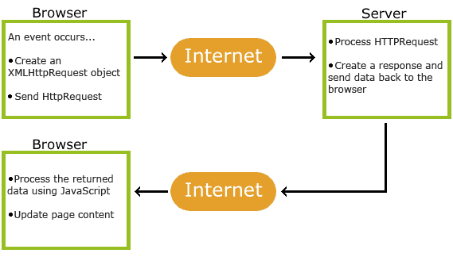
AJAX Basics
How AJAX Works:

Slide 14
AJAX Basics
How AJAX Works:
1. An event occurs in a web page (the page is loaded, a button is clicked)
2. An XMLHttpRequest object is created by JavaScript
3. The XMLHttpRequest object sends a request to a web server
4. The server processes the request
5. The server sends a response back to the web page
6. The response is read by JavaScript
7. Proper action (like page update) is performed by JavaScript

Slide 15
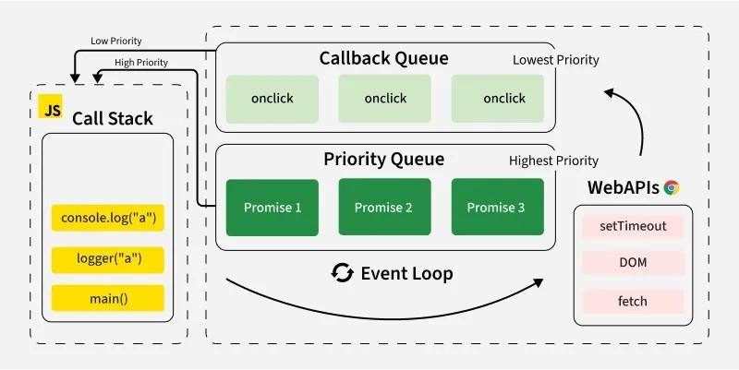
Event Loop in JavaScript

Slide 16
Event Loop in JavaScript
Phases of the Event Loop:
The event loop operates in multiple phases.
Timers Phase: Executes callbacks from setTimeout and setInterval.
I/O Callbacks Phase: Handles I/O operations like file reading, network requests, etc.
Prepare Phase: Internal phase used by Node.js.
Poll Phase: Retrieves new I/O events and executes callbacks.
Check Phase: Executes callbacks from setImmediate.
Close Callbacks Phase: Executes close event callbacks.
Microtasks Execution: After each phase, the event loop processes the microtask queue before moving to the next phase.

Slide 17
Concurrency Model
The concurrency model of JavaScript is based on the concept of an “event loop”.
This model enables JavaScript to carry out non-blocking I/O operations despite being a single-threaded language.
This capability is made possible by offloading certain operations to the system kernel whenever possible.

Slide 18
Concurrency Model
Example:
// First
console.log('Start');
// Second
setTimeout(() => {
// Fifth: Callback function is not executed until after the delay.
console.log('Timeout');
}, 2000);
// Third
console.log('End');
OUTPUT:
Start
End
Timeout

Slide 19
Introduduction to GIT
Git is an essential Version Control System (VCS) used by JavaScript developers to track changes, collaborate with teams, and manage project history.
Core Concepts for JavaScript Developers
Repository(Repo): A folder where Git tracks every change made to your code.
Commit: A "snapshot" of your project at a specific point in time. Each commit has a unique ID (hash).
Staging Area (Index): A middle ground where you prepare changes before officially committing them.
Branch: An independent line of development. Developers often create branches for new features to avoid breaking the main code.
Remote: A version of your project hosted on the internet (e.g., GitHub, GitLab, or Bitbucket).

Slide 20
Introduduction to GIT
Standard Workflow:
Initialize: Create a new repository in your project folder using the Git Command Line.
git init
Stage: Tell Git which files (like app.js or index.html) you want to include in the next update.
git add app.js
# Or add all changes
git add .
Commit: Save the staged changes with a descriptive message.
git commit -m "Add login validation logic"
Push: Upload your local commits to a remote server like GitHub.
git push origin main

Slide 21
Thank You

